Slide 1
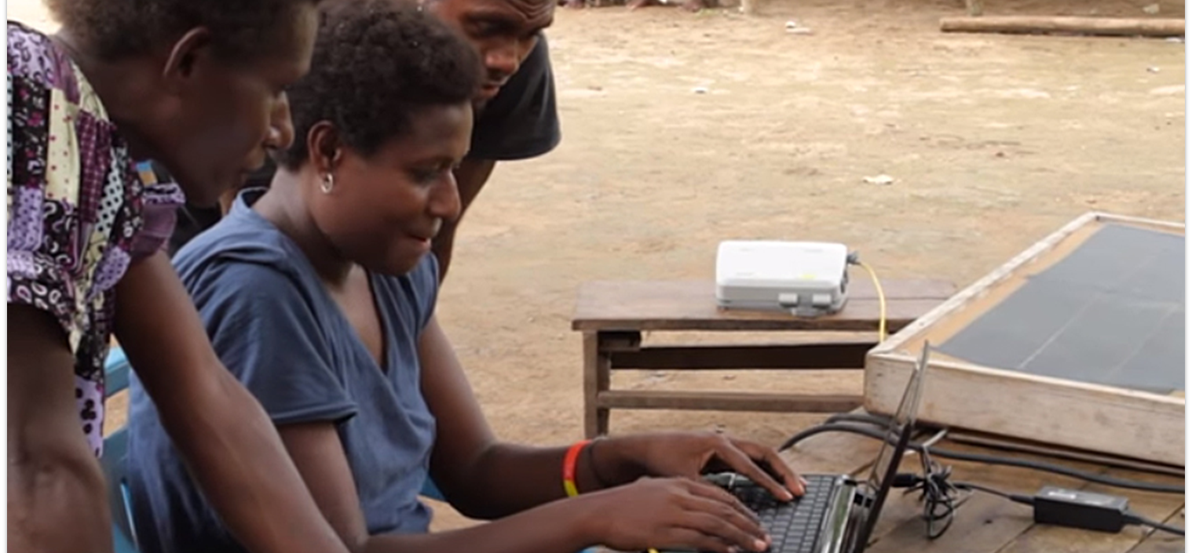
Where there is no counsel, a nation falls, but victory comes through many counselors (Prov. 11:14).
All Scripture taken from the English Unlocked Literal Bible (ULB), ©2017, 2022 Wycliffe Associates, Available at https://bibleineverylanguage.org/translations, licensed under the Creative Commons Attribution-ShareAlike 4.0 International License.
The English ULB is based on the unfoldingWord® Literal Text, CC BY-SA 4.0. The original work of the unfoldingWord® Literal Text is available at https://unfoldingword.bible/ult/.
Refinement and Revision Overview

Slide 2
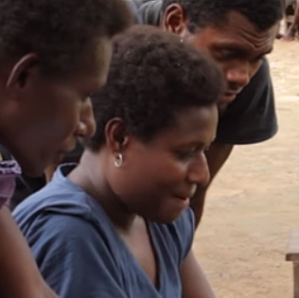
After the 8 Steps of Translation
Refinement: a process that includes other Christians from the language community

Slide 3
Ecclesiastes 4:9-12
Two people work better than one;
together they can earn a good wage for their labor.
For if one falls,
the other can lift up his friend.
However, woe to the one who is alone when he falls
if there is no one to lift him up.
If two lie down together, they can be warm,
but how can one be warm alone?
One man alone can be overpowered,
but two can withstand an attack,
and a three-strand rope is not quickly broken.

Slide 4
?
Generate Scripture interest
Insight: how community understands translation
Why include others?
Build relationships and ownership

Slide 5
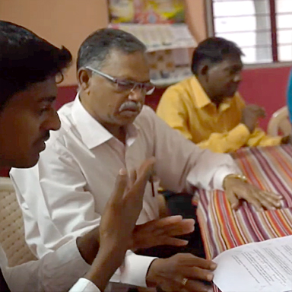
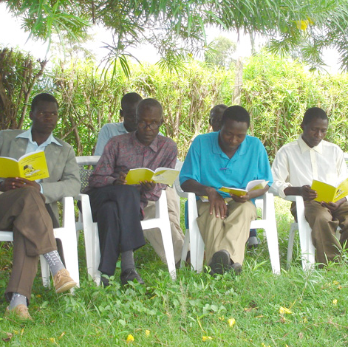
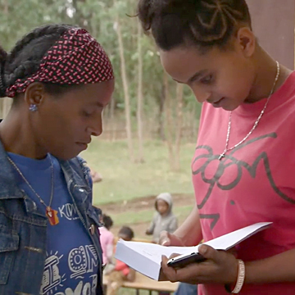
How to Include Others
Bible study/small group activity
Sunday school class
One-on-one in homes

Slide 6
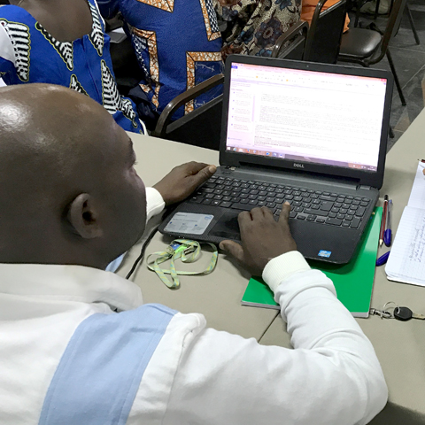
Refinement and Revision Resources
Quality Assessment Guide Checklist
Reviewers’ Guides
New Testament Survey
Old Testament Surveys
Divine Familial (Family) Terms Chart
Application Guides for Doctrines
Spiritual Terms Evaluation Tool
Proofreading Checklist

Slide 7
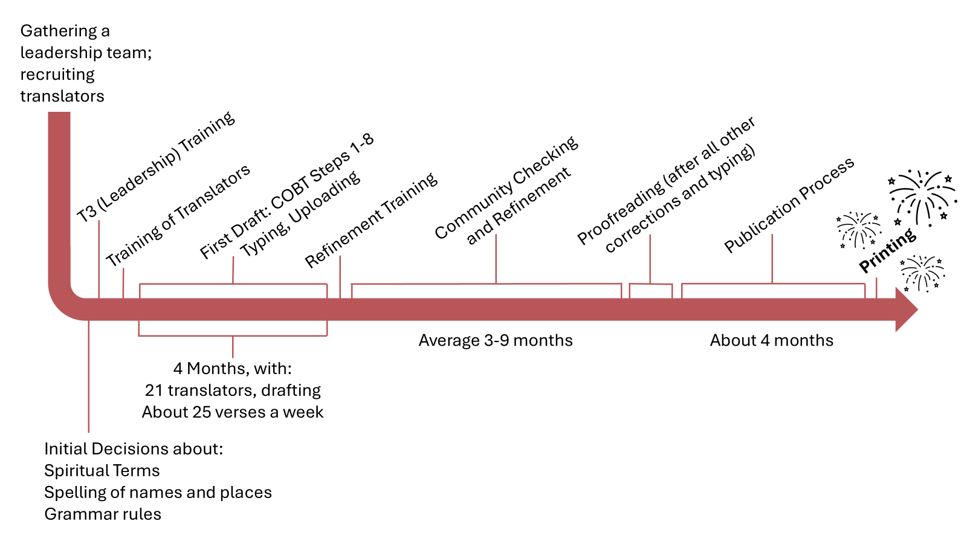
Sample Timeline for New Testament Completion

Slide 8
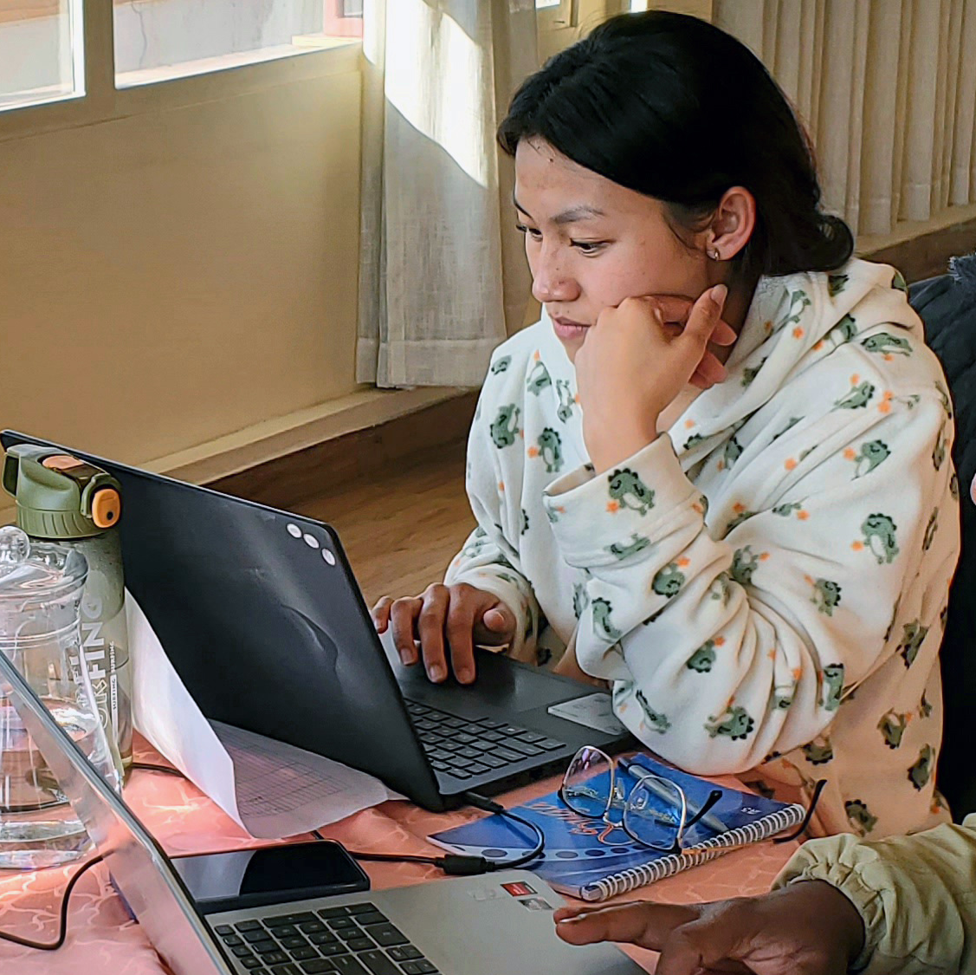
Checking Resources Used During the 8 Steps
Quality Assessment Guide
Bible Commentary
Translation Notes
Translation Words
Translation Topics
Greek Words for Translators

Slide 9
Refinement Resources
Activity | When is it used? | Who uses this?
Quality Assessment Guide | Steps 5-8 of the COBT 8 Steps; also used after the 8 Steps are complete | Translators; later used by mother-tongue believers in the community reviewing the completed translation
Reviewers’ Guide | Used after the COBT 8 Steps, when the project files have been completed and are accessible on bibleineverylanguage.org | Mother-tongue believers not on the translation team (led by a church leader or member of the translation team)
Spiritual Terms Evaluation tool | Used after the COBT 8 Steps, when the project files have been completed and are accessible on bibleineverylanguage.org | Translators with other spiritual leaders
Proofreading | LAST step, right before publishing | One or two translators

Slide 10
Revision Keeping the Translation Current/ Generational Ownership
Language changes over time...
Plan by the church to revise the translation
When need is identified
Every 5 years or other

